Slide 1
Used Car Price Prediction Project Presentation
Submitted by Sri Bharath Vasa

Slide 2
ACKNOWLEDGMENT
All the external resources that were used in creating this project are listed below:
1) https://www.google.com/
2) https://www.youtube.com/
3) https://scikit-learn.org/stable/user_guide.html
4) https://github.com/
5) https://www.kaggle.com/
6) https://medium.com/
7) https://towardsdatascience.com/
8) https://www.analyticsvidhya.com/

Slide 3

PROBLEM STATEMENT
With the covid 19 impact in the market, we have seen lot of changes in the car market. Now some cars are in demand hence making them costly and some are not in demand hence cheaper. One of our clients works with small traders, who sell used cars. With the change in market due to covid 19 impact, our client is facing problems with their previous car price valuation machine learning models. So, they are looking for new machine learning models from new data. We have to make car price valuation model.

Slide 4
DATA COLLECTION PHASE
You have to scrape at least 5000 used cars data. You can scrape more data as well, it’s up to you. more the data better the model
In this section You need to scrape the data of used cars from websites (OLX, Car Dekho, Cars 24 etc.) You need web scraping for this. You have to fetch data for different locations. The number of
columns for data doesn’t have limit, it’s up to you and your creativity. Generally, these columns are Brand, model, variant, manufacturing year, driven kilometers, fuel, number of owners, location and at last target variable Price of the car. This data is to give you a hint about important variables in used car model. You can make changes to it, you can add or you can remove some columns, it completely depends on the website from which you are fetching the data.
Try to include all types of cars in your data for example- SUV, Sedans, Coupe, minivan, Hatchback.

Slide 5
MODEL BUILDING PHASE
After collecting the data, you need to build a machine learning model. Before model building do all data pre-processing steps. Try different models with different hyper parameters and select the best model. Follow the complete life cycle of data science. Include all the steps below.
1. Data Cleaning
2. Exploratory Data Analysis
3. Data Pre-processing
4. Model Building
5. Model Evaluation
6. Selecting the best model

Slide 6
DATA SCIENCE LIFE CYCLE
Data Cleaning
Import the collected data from web scraping
Exploratory Data Analysis
Check through all the dataset information like datatype, missing value, duplicate value etc.
Visualization and Data Preprocessing
Use various visualization methods to check the data distribution identify presence of outliers and skewness
Clean and format the records as per usage by using various imputation techniques
Analyze each and every data record to ensure we have usable information
Perform encoding and scaling methods

Slide 7
DATA SCIENCE LIFE CYCLE
Model Building
Create appropriate Regression Machine Learning model function
Model Evaluation
Usage of evaluation metrics to check the accuracy of the models over trained and test data inputs
Hyperparameter Tuning Best Model
Choosing the appropriate Regression Machine Learning model to check various parameter permutation and combinations
Need to ensure that whenever the regression function is called it is able to process all the necessary parameters
Ensure the cross validation techniques helps in reducing over fitting and under fitting data
Using Grid Search CV to obtain the best parameters that can be plugged into the selected model

Slide 8
WEB SCRAPING FOR USED CAR DETAILS

Slide 9
DATA PREPROCESSING
Importing the necessary dependencies and libraries.
Reading the CSV file and converted into data frame.
Checking the data dimensions for the original dataset.
Looking for null values and accordingly fill the missing data.
Checking the summary of the dataset.
Checking unique values.
Checking all the categorical columns in the dataset.

Slide 10
DATA PREPROCESSING
Visualizing each features using matplotlib and seaborn.
Performing encoding using the ordinal encoder on categorical features.
Checking for co-relation/multi-collinearity in a heatmap.
Checking for Outliers/Skewness using boxen plot and distribution plot.
Perform Scaling using Standard Scaler method.
Checking for the final dimension of dataset to confirm the input details.
Creating train test split and the best random state found in the range 1-1000.

Slide 11
TECHNOLOGY USED
Hardware technology being used.
RAM : 12 GB
CPU : intel corei5 11th generation 2.40GHz
GPU : intel iRIS Xe graphics card
Software technology being used.
Programming language : Python
Distribution : Anaconda Navigator
Browser based language shell : Jupyter Notebook
Libraries/Packages specifically being used.
Pandas, NumPy, matplotlib, seaborn, scikit-learn, pandas-profiling, missingno

Slide 12
EXPLORATORY DATA ANALYSIS (EDA) AND VISUALIZATION
01. Univariate Analysis
02. Multivariate Analysis
03. Correlation of Dataset
Univariate analysis is the simplest form of analyzing data. “Uni” means “one”, so in other words your data has only one variable.
Multivariate analysis is a set of statistical techniques used for analysis of data that contain more than one variable.
Correlation is used to test relationships between quantitative variables or categorical variables.
04. Correlation with Target variable
05. Conclusion
Correlation with the target variable to know how the data is related.
Summary with the conclusion of all the analysis

Slide 13
EXPLORATORY DATA ANALYSIS (EDA)
Shape : 10,000 rows and 6 columns
No null values present
Few duplicate rows/records were found
Datatype of only object columns are in dataset
First I have imported the necessary libraries and loaded the entire dataset in our Jupyter Notebook and renamed the project file from untitled.
Then I checked the shape of our dataset and found that we have a total of 10,000 rows and 6 different columns.
We don’t have any null values or missing values present in our dataset from the web scraping.
There few duplicate rows/records in our dataset but I decided to retain them instead of deleting it.
By checking the data types I came to know that our data set consists of columns having only object datatype even those there were numeric information present.

Slide 14
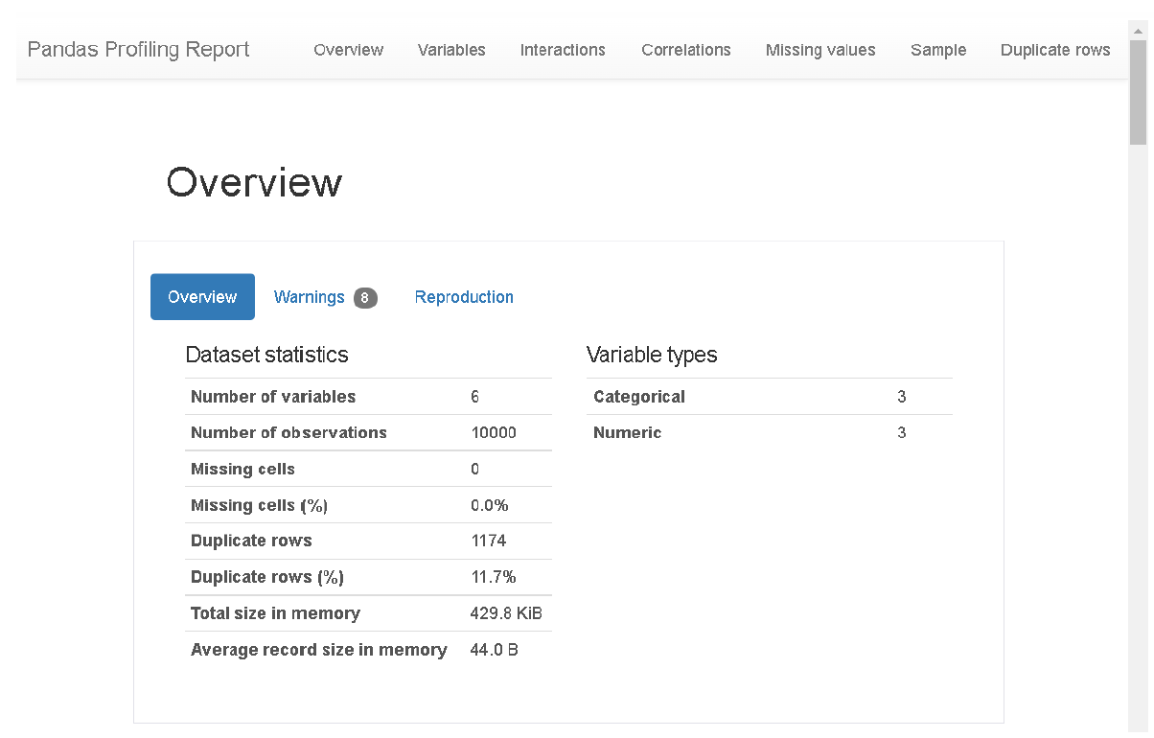
VISUALIZATION USING PANDAS PROFILING REPORT

Slide 15
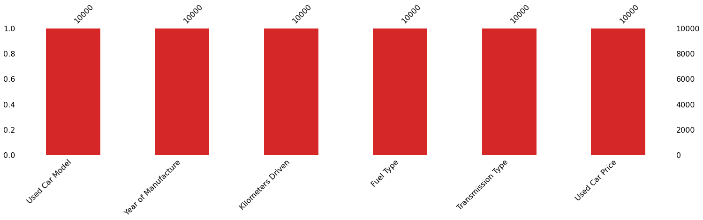
MISSING VALUES VISUAL USING MISSINGNO

Slide 16
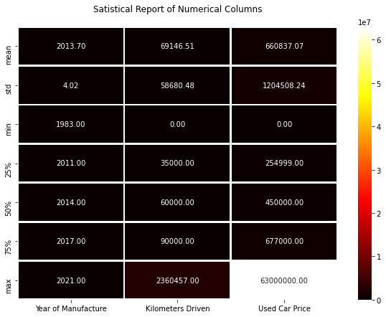
DESCRIBE DATASET VISUAL ON NUMERIC DATA

Slide 17
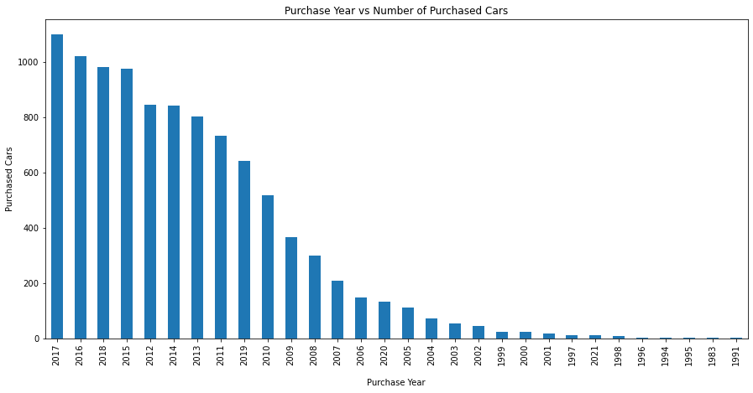
PURCHASE DETAILS OF USED CARS EACH YEAR

Slide 18
COUNT PLOTS

Slide 19
BAR PLOTS

Slide 20
PAIR PLOTS

Slide 21
OUTLIERS WITH BOXEN PLOTS

Slide 22
SKEWNESS WITH DISTRIBUTION PLOTS

Slide 23
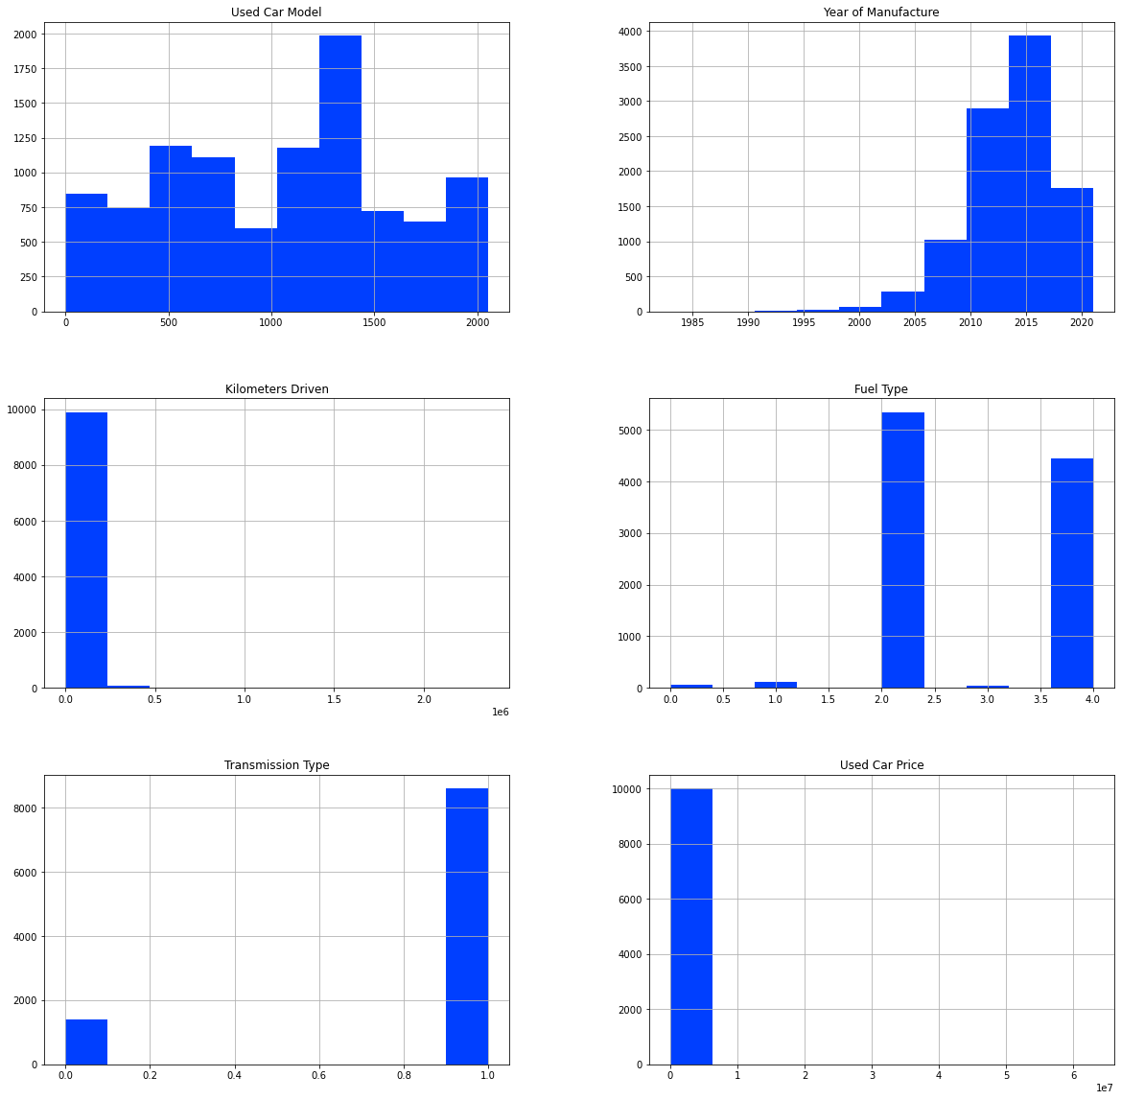
HISTOGRAM

Slide 24
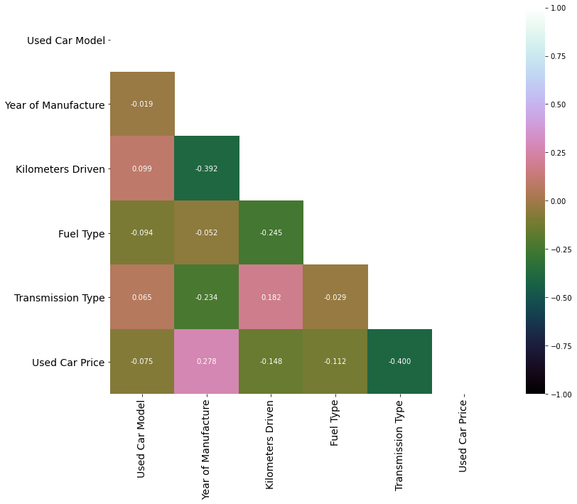
HEATMAP

Slide 25
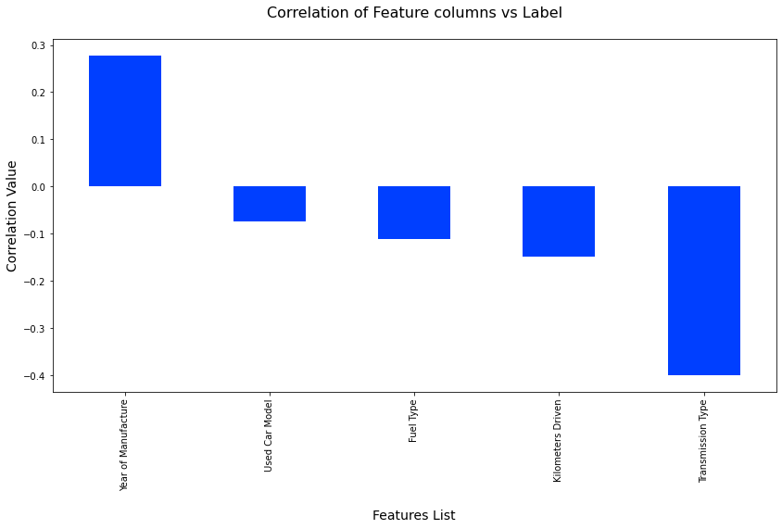
CORRELATIONS BAR GRAPH

Slide 26
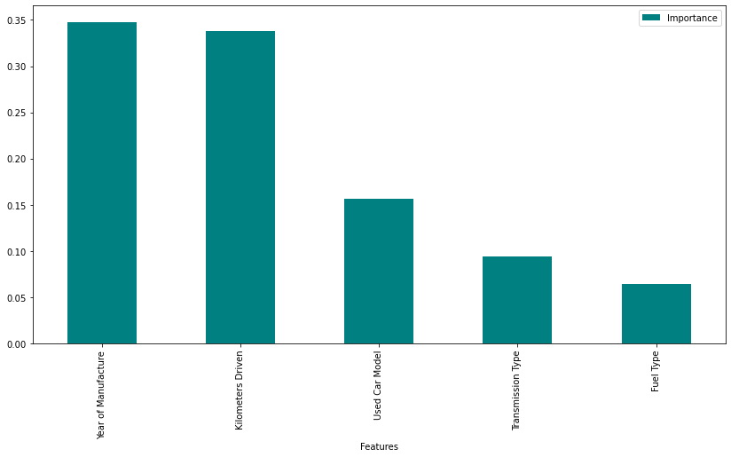
FEATURE IMPORTANCE BAR GRAPH

Slide 27
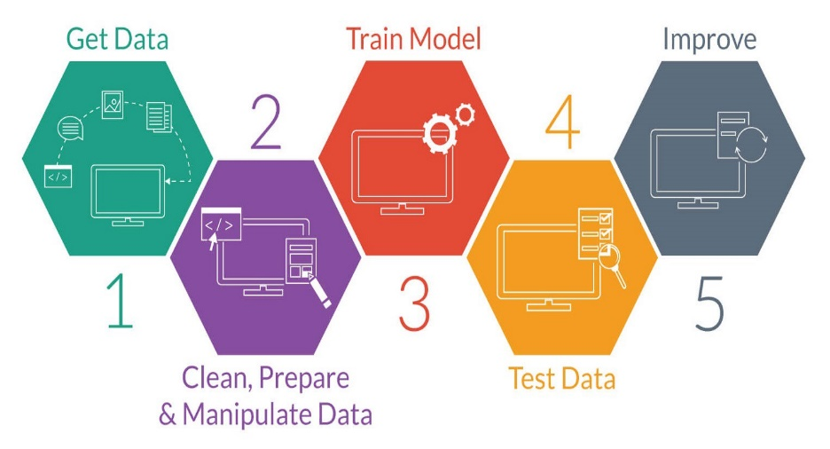
MODEL TRAINING PHASES

Slide 28
REGRESSION MACHINE LEARNING MODEL/S USED
▪ Linear Regression Model
▪ Ridge Regularization Model
▪ Lasso Regularization Model
▪ Support Vector Regression Model
▪ Decision Tree Regression Model
▪ Random Forest Regression Model
▪ K Neighbours Regression Model
▪ Gradient Boosting Regression Model
▪ Ada Boost Regression Model
▪ Extra Trees Regression Model

Slide 29
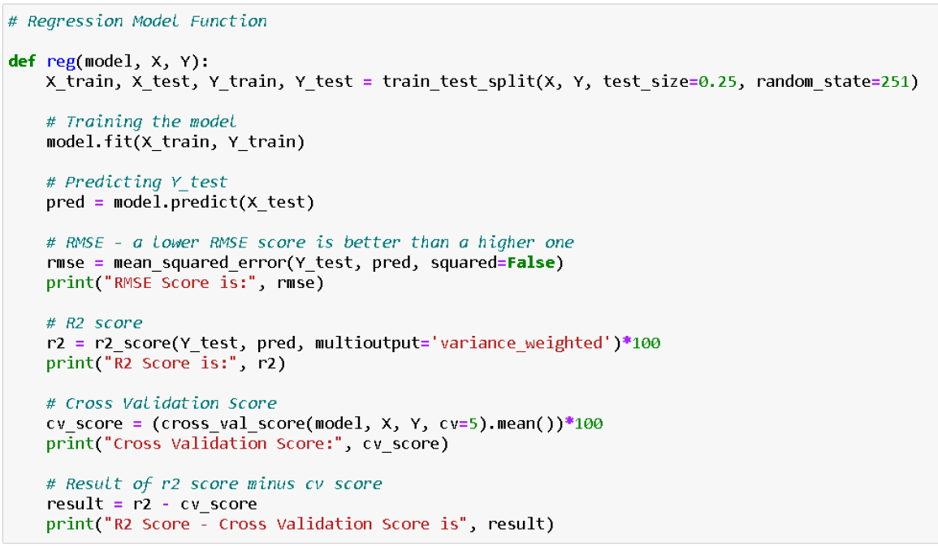
REGRESSION MODEL FUNCTION WITH EVALUATION METRICS

Slide 30
RESULT OF MULTIPLE REGRESSION MODELS

Slide 31
EVALUATION AND HYPER PARAMETER TUNING
The key metrics used here were:
R2 score
Cross Validation Score
MAE
MSE
RMSE
We tried to find out the best parameters list to increase our accuracy scores by using Hyperparameter Tuning. In order to achieve a higher score we used the Grid Search CV method with 5 folds.

Slide 32
CONCLUSION
After the completion of this project, we got an insight on how to collect data, pre-processing the data, analyzing the data and building a model. First, we collected the used cars data from different websites like OLX, Car Dekho, Cars 24, OLA etc. and it was done by using Web Scraping.
The framework used for web scraping was Beautiful Soup and Selenium, which has an advantage of automating our process of collecting data. We collected almost 10000 of data which contained the selling price and other related features of used cars. Then the scrapped data was combined in a single data frame and saved in a csv file so that we can open it and analyze the data.

Slide 33
CONCLUSION
We did data cleaning, data pre-processing steps like finding and handling null values, removing words from numbers, converting object to int type, data visualization, handling outliers and skewness etc. After separating our train and test data, we started running different machine learning regression algorithms to find out the best performing model.
We found that Extra Tree Regressor Algorithm was performing well according to their r2_score and cross validation scores. Then we performed Hyperparameter Tuning technique using Grid Search CV for getting the best parameters and improving the score. In that Extra Tree Regressor Algorithm did not perform quite well as previously on the defaults but we finalized that model for further predictions as it was still better than the rest. We saved the final model in pkl format using the joblib library after getting a dataframe of predicted and actual used car price details.

Slide 34
LIMITATIONS OF THIS WORK AND SCOPE FOR FUTURE WORK
The limitations we faced during this project were:
The website was poorly designed because the scrapping took a lot of time and there were many issues in accessing to next page. Also need further practice in terms of various web scraping techniques. More negative correlated data were present than the positive correlated one's. Presence of outliers and skewness were detected and while dealing with them we had to lose a bit of valuable data. No information for handling these fast-paced websites were provided so that was consuming more time in web scraping part.
Future Work Scope:
Current model is limited to used car data but this can further be improved for other sectors of automobiles by training the model accordingly. The overall score can also be improved further by training the model with more specific data.

Slide 35


